Slide 1

Windows 10 shortcuts
Abdul Wahab amir

Slide 2
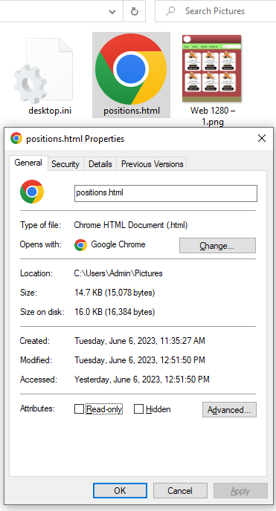
Alt + Enter: Show the Properties menu for the selected file or item.

Slide 3
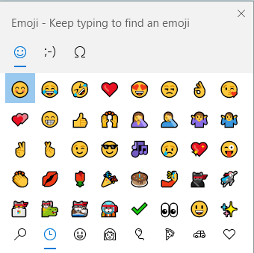
Windows key + Period (.): Open the emoji panel.
Windows key + Semicolon (;): Open the emoji panel.

Slide 4
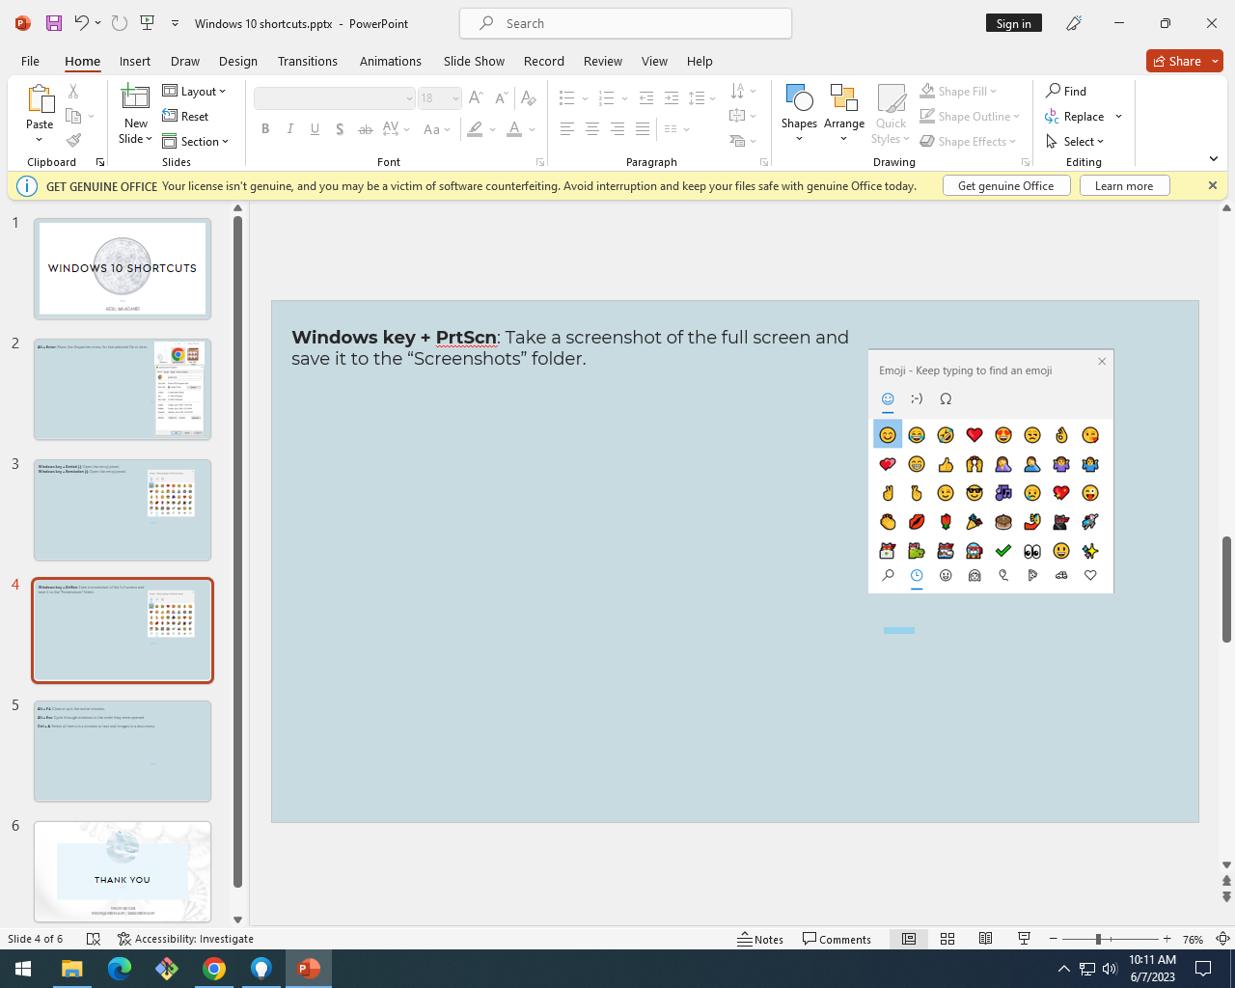
Windows key + PrtScn: Take a screenshot of the full screen and save it to the “Screenshots” folder.

Slide 5
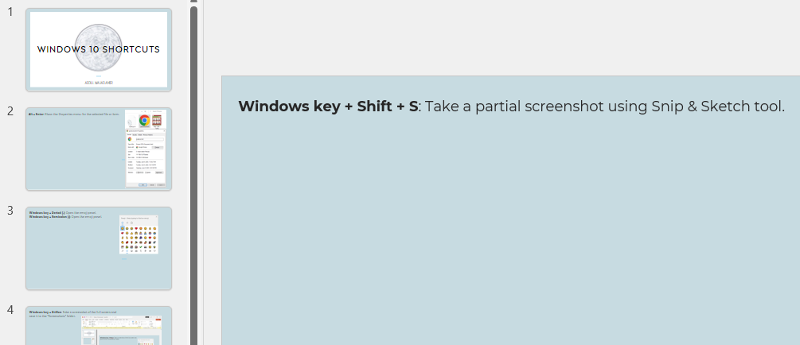
Windows key + Shift + S: Take a partial screenshot using Snip & Sketch tool.

Slide 6
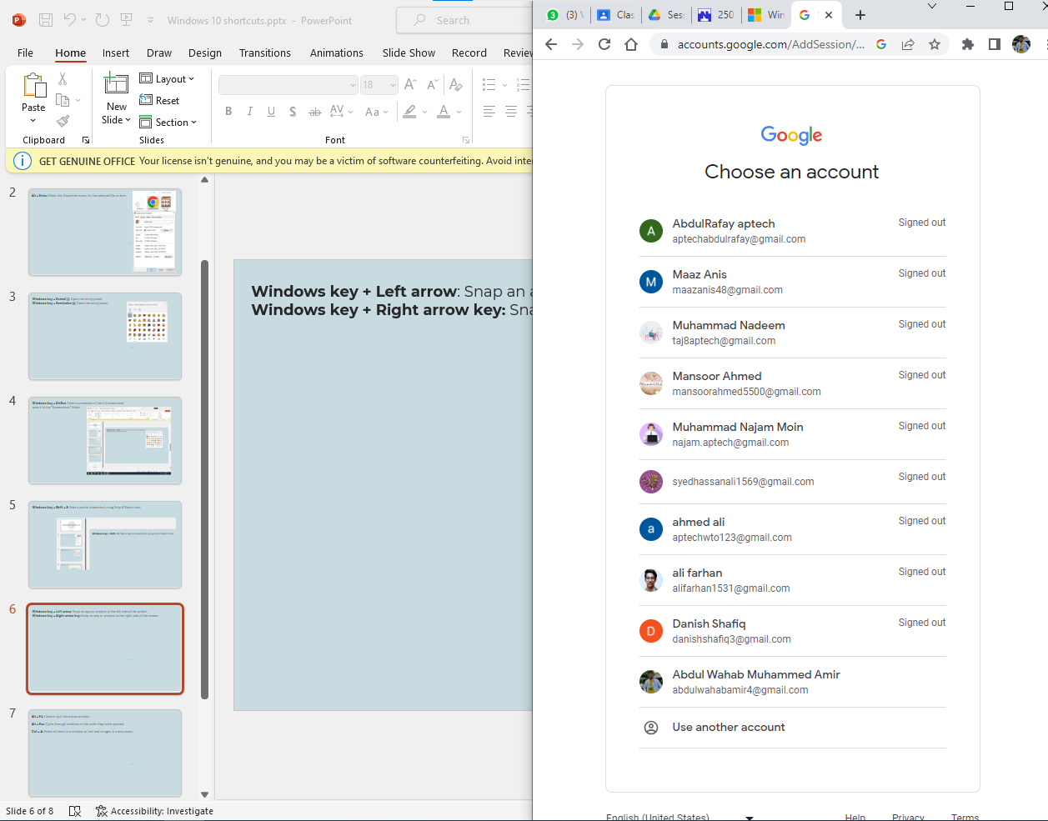
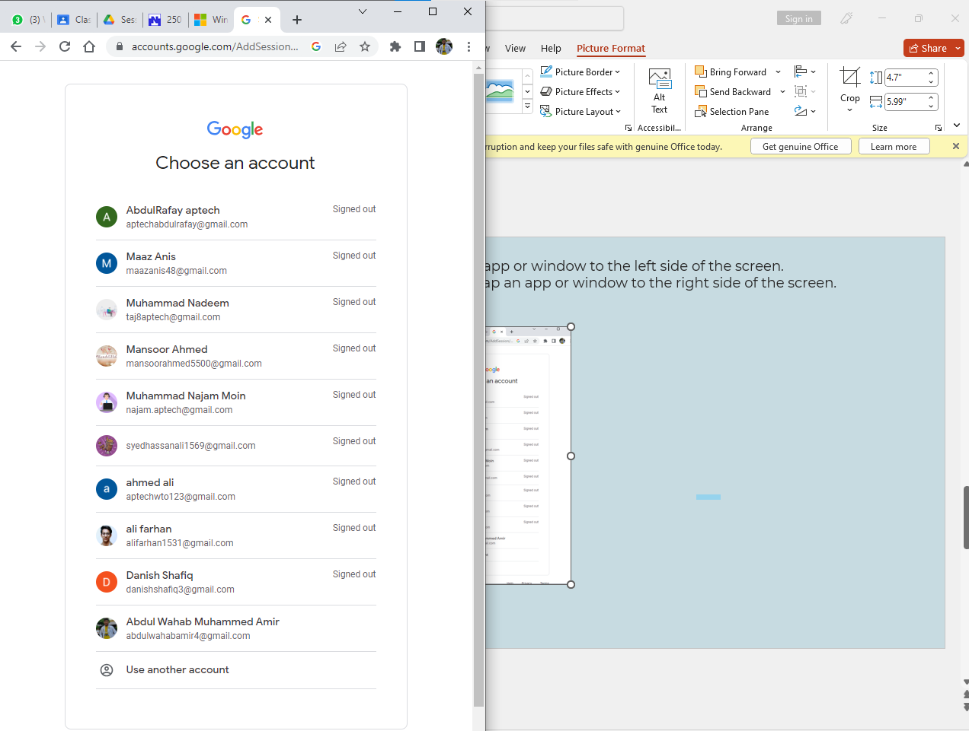
Windows key + Left arrow: Snap an app or window to the left side of the screen.
Windows key + Right arrow key: Snap an app or window to the right side of the screen.

Slide 7
Alt + F4: Close or quit the active window.
Alt + Esc: Cycle through windows in the order they were opened.
Ctrl + A: Select all items in a window or text and images in a document.
Windows key + A: Open the Action Center.
Windows key + D: Display or hide the desktop.
Windows key + E: Open the File Explorer.
Windows key + I: Open the Settings app.
Windows key + L: Lock your computer. You can also make your PC lock itself automatically when you move away using

Slide 8


Thank you

